Slide 1

Echoes of the Spanish Lady: Navigating the Maze of Epidemic Models
A Look at the 1918 Flu Epidemic Models

Slide 2
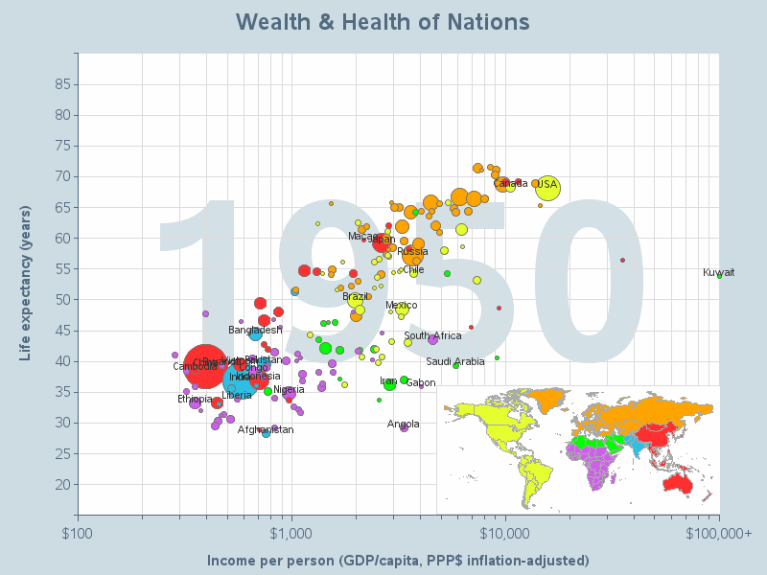
Gapminder.org

Slide 3
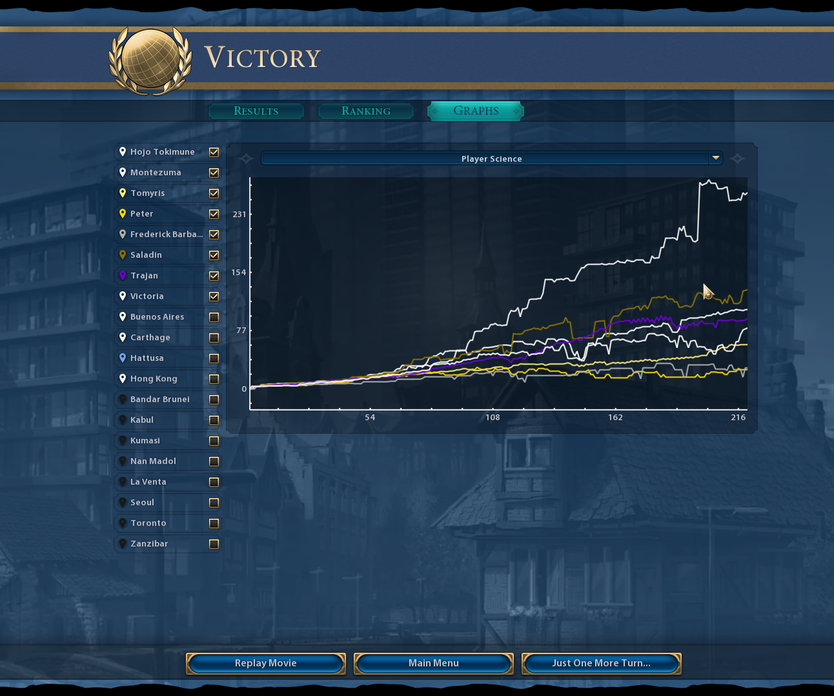
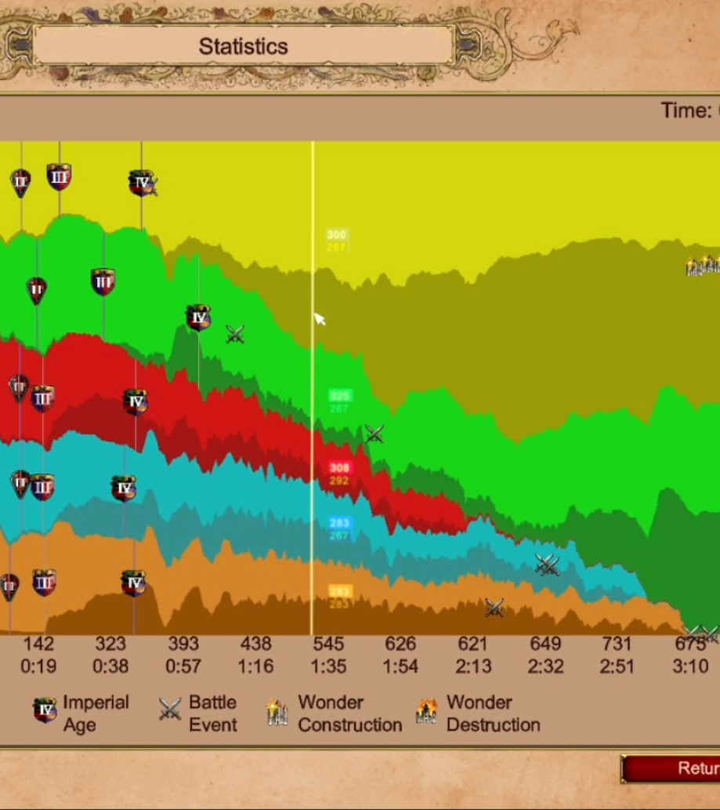
Civilization & Age of Empires Game Over Screen Graphs

Slide 4
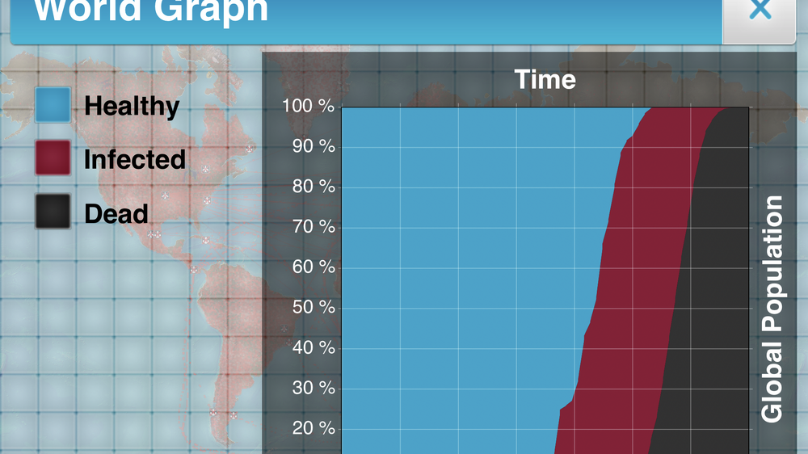
Plague Inc., Video Game

Slide 5

Project Development

Slide 6
Computational Science Project Schedule
Week of June 7
For June 21
For June 30
Defining the project scope and goals.
Clarity and feasibility of the project scope and goals.
Completeness of the project proposal
Literature review and research on existing methods
Breadth and depth of the literature review
Relevance of the literature to the project
Evidence of understanding the existing methods
Developing the computational method/algorithm:
Quality and completeness of the implementation
Evidence of testing and debugging of the method/algorithm
Evidence of understanding and implementation of the method/algorithm

Slide 7
Future Goals and Objectives
July 14
July 28
August 11
Testing and optimization of the method/algorithm:
Evidence of understanding and implementation of optimization techniques
Evidence of testing and debugging of the optimization techniques
Scalability and computational efficiency of the method.
Verification and validation of the method/algorithm:
Evidence of understanding and implementation of verification and validation techniques
Evidence of testing and debugging of the optimization techniques
Quality and completeness of the results
Final Report/Presentation Preparation
Clarity and organization of the final report/presentation
Quality and completeness of the visual aids
Effectiveness of the delivery

Slide 8
Introduction
Mathematical Modeling of Infectious Diseases
Kermack-McKendrick Model
Cellular Automata and Markov Chains

Slide 9
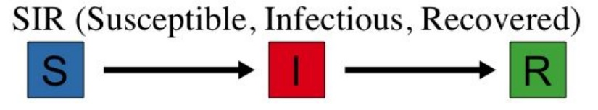
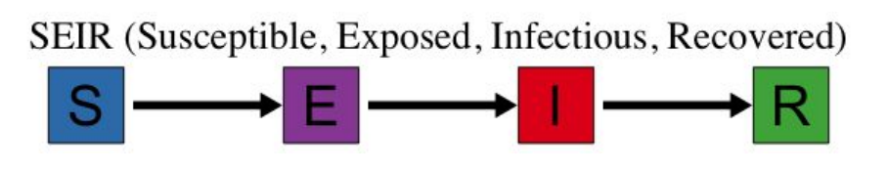
Basic SIR Model

Slide 10
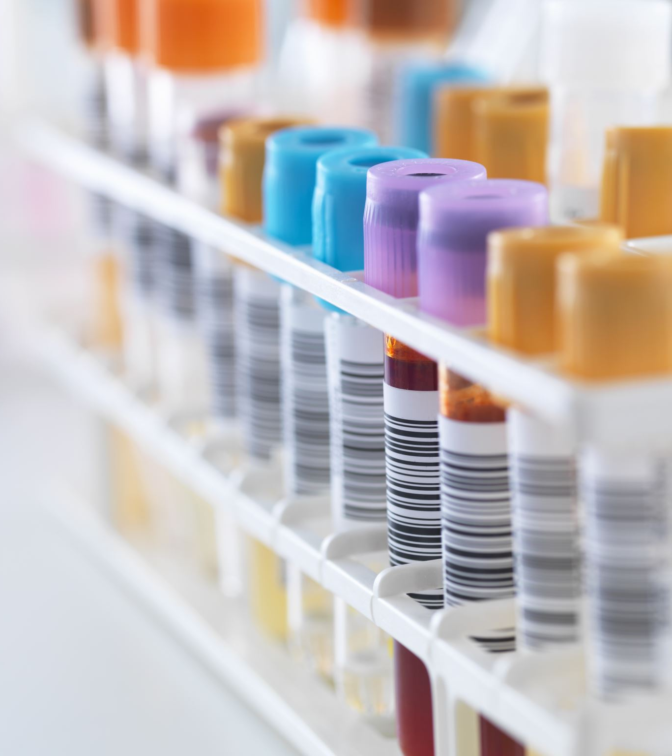
The Corrupted Blood Incident
9/13/2005, World of Warcraft
Release of new content: Blood God “Hakkar the Soulflayer“ for high level Avatars, during battle, Hakkar cast the spell “corrupted blood“ (CB) on random Avatars
Corrupted Blood hit with severe damage: once plus additional damage over time; duration 10 seconds
Spread from Avatar to Avatar: INFECTIOUS
CB was never meant to leave Zul‘Gurub, but infected Avatars could teleport to cities
Hunters could dismiss their pets and call them back, still infected in cities

Slide 11


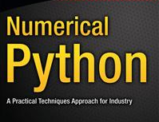

Slide 12
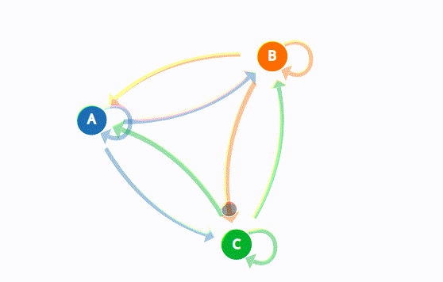
Markov Chain Example & Walk

Slide 13
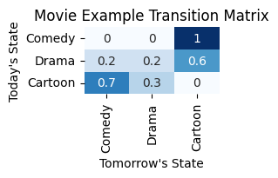
Markov Chain Example and SIR Example
If we watch a comedy today 100% we watch a comedy tomorrow.
If we watch a drama today, 20% chance tomorrow we watch comdey, 20% another drama and 60% Cartoon
If we watch cartoon today, 70% catroon tomorrow and 30% drama tomorrow.

Slide 14
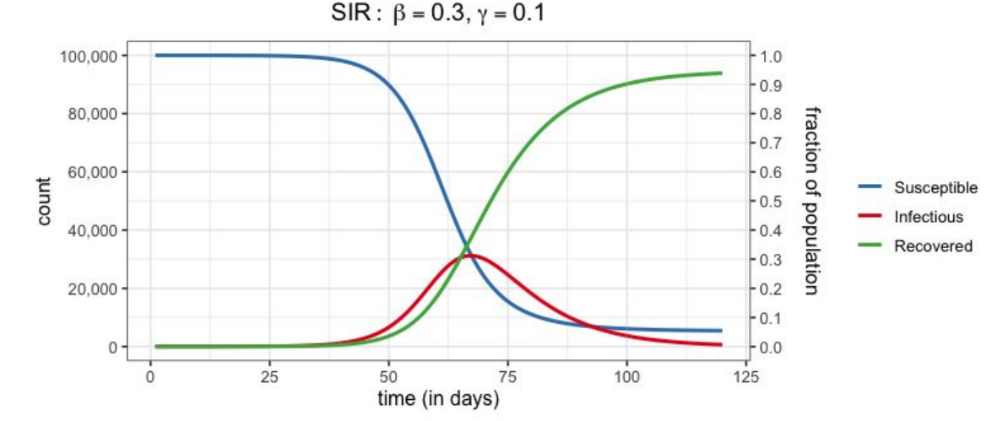
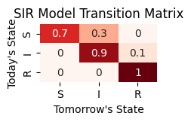
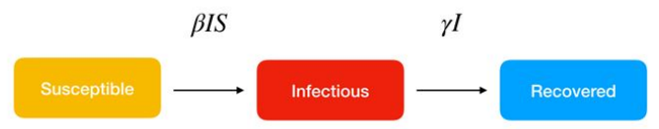

SIR Example over Time Syphilis, simplified to $30\% β$and $10\% γ$
Graphical representation on the SIR model (Susceptible, Infectious and Recovered) above, and below their structure and dynamics in flow charts.

Slide 15
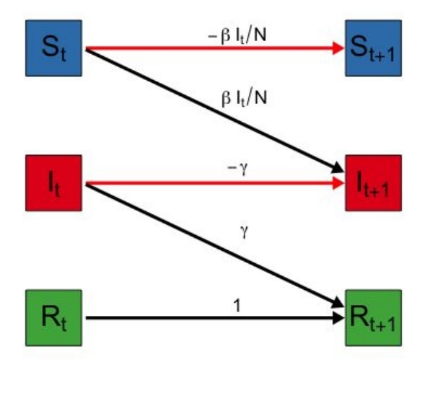
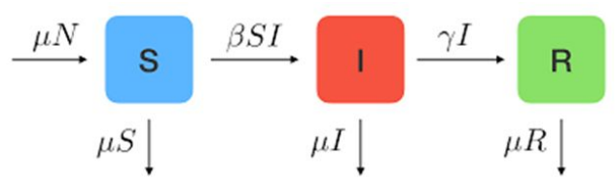
Differential Equations Model of SIR Transformations

Slide 16
Background & Project Focus
Leveraging cellular automata for simulating epidemic models, specifically the SIR (Susceptible, Infected, Recovered) model. Demonstrate the effectiveness of cellular automata in simulating the SIR models, showcasing an alternative to traditional methods.
The goal is to compare the efficiency and accuracy of these models with traditional techniques like Markov Chains, to develop more efficient and practical tools for simulating disease spread and understand the balance between model refinement and overfitting.
Explore the practicality and applicability of these simulation tools beyond academic research, such as their use in public health planning or game development.

Slide 17
Simulation & Data Analysis
The simulation uses cellular automata to model the spread of an infectious disease based on SIR models.
We represent the population as a 2D grid, each cell corresponds to an individual and its state: Susceptible, Infected, or Recovered.
The initial state of each cell is randomly assigned to reflect a realistic distribution of population states at the spread of a disease.
By assigning different portions of the grid to multiple processes, we aim to enhance computational efficiency.
The simulation rules apply for each time-step.
The state will evolve based on these rules, and the aggregate state of the population will be captured and analyzed.
As the SIR and SEIR models involve ordinary differential equations, numerical integration methods are used for their solution
Ultimately, we aim to generate a rich dataset that provides insight into the temporal dynamics of disease spread and the comparative efficiency and accuracy of SIR model when implemented.

Slide 18
Programming & Development
1. Setting Up the Simulation Environment
2. Implementing SIR Models
3. Running the Simulation
4. Data Analysis and Model Refinement
5. Machine Learning Integration

Slide 19
Real World Implications
Unforeseen virality
MERS humidifier spread 2015
Killing Black Cats during Plague
Disinformation

Slide 20
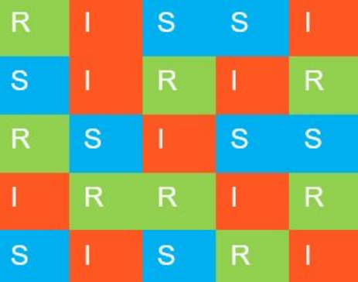
Oversimplified Model Cellular Automata Method (simple,forced probability) Can this method also produce similar graphs to traditional computational methods?

Slide 21
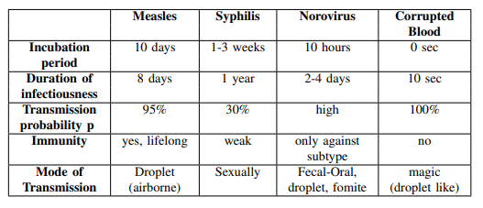
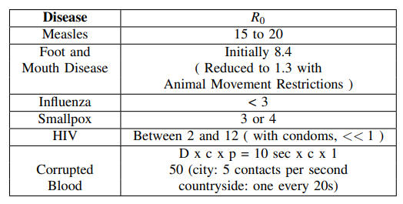
Data Sets
Data Modelling Infectious Diseases in Virtual Realities
Adapted from presentation at a video game conference in 2011 [22] in paper.
Florian Burckhardt MSc Epidemiology

Slide 22

Results
This approach allows to refine the parameters of our model iteratively to improve its predictive accuracy while preventing overfitting.
Because this is a fictional disease, it can be matched against known diseases in various ways, depend on what future metrics we would find interesting.

Slide 23
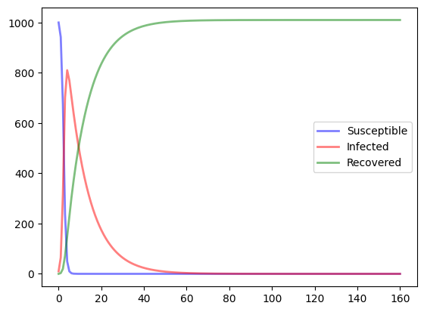
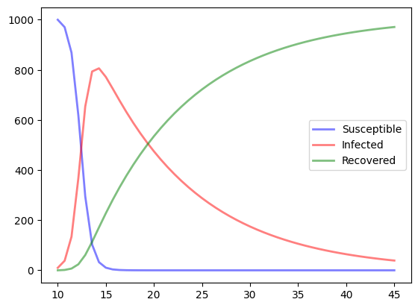
Susceptible Infected Recovered over Time using Cellular Automata on Corrupted Blood

Slide 24
Analysis
This serves as a baseline for proof-of-concept that this method can produce results in the neighborhood of more traditional methods.
In terms of data analysis, we introduce the concept of an 'error function' that assesses the difference between the simulated data and real-world observations.

Slide 25

Future Work
To test the model results against T. Torku et al’s COVID-19 Machine Learning Algorithm Models
To run these samples on different disease models (for example, SEIR, vaccinated/unvaccinated)
To model other social phenomena and compare with “End Game Graphs”
Establish a groundwork for future research, such as the inclusion of more complex factors in epidemic models (like vaccination rates) and the potential for a reverse-engineering approach to model selection

Slide 26

Acknowledgements
Research Advisor & Team
Team meets weekly to support each other on nuances of research, presentation, and communication techniques
A collaborative group with diverse backgrounds serves to facilitate developing proficiency and mastery of research skills

